Slide 1
Student Information Management System
Group-1
Sathya Cheeti
Bhanu Prasad Namburi
Veerraju Palacharla

Slide 2
Objectives:
The main objective of this project is to create an efficient database for tracking student performance by storing student results, student course enrollments and few other student details.
It can be used to manage the details of profiles, courses, logins, exams, fees, assignments.
It can also be used to generate a term-wise students’ performance reports.
Using our system we add or edit courses, terms, and new student enrollments.
This project is useful for administrative purposes for getting and storing the results in a simple manner.

Slide 3
Scope:
Our database mainly consists of the following tables: Student, student address, Student enrolment, Department,Faculty, Courses, Terms, sections, and Student Financials details.
Our database provides an easy-to-use interface for the students to retrieve information in a timely and reliable manner.
This complete database was built to make administrative tasks easier and more efficient.
The project provides facilities like online registration and profile creation of students thus reducing paperwork and automating the record generation process in an educational institution.

Slide 4
User Requirements:
The database must be able to register new students.
Make changes to the student information.
Look for a specific student or a group of students based on Student ID, department, courses enrolled.
It should add and modify the Term details.
Record the course details and subject information.
Make changes to the course details.
Keep track or modify the student internal grades.
Register a employee or teacher.
It should maintain details student Payments.

Slide 5
Choice of DBMS:
MySQL

Slide 6
Business Rules:
A Student can enroll in multiple Sections.
Each Section can have multiple Students enroll.
Each Faculty is assigned to multiple Sections.
Each Section is assigned to exactly one Faculty person.
A Term can have multiple Courses.
Each Course is belonging to particular Term.
A Student must have one Student Payment Details record.
Each Student Payment Details record belongs to exactly one student.
A Student have one Student Address.

Slide 7
Each Student Address belongs to exactly one record.
A Department can have one or more Faculties.
Each Faculty belongs to only one Department.
Every department can have one or more Students.
Each student belongs to only one Department.
Each Course can have one or more Sections.
Every Section have only one Course.
A Department can offer multiple Courses.
Each Course should belong to exactly one Department

Slide 8
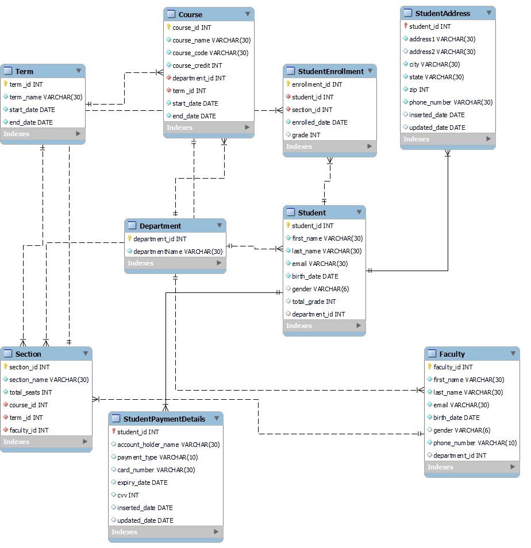
ERD Diagram:

Slide 9
Data Directory: Table: Student
Name | Constraint | Data Type | Size | Description
student_id | Primary Key | INT | 11 | A unique Id assigned to each student
first_name | Not Null | VARCHAR | 30 | First name of the student
last_name | Not Null | VARCHAR | 30 | Last name of the student
email | Not Null | VARCHAR | 30 | Email of the student
birth_date | Not Null | DATE | 10 | Date of birth of the student
gender | Null | VARCHAR | 6 | Gender of the student
total_grade | Null | INT | 11 | Total grade of the student
department_id | Foreign Key | INT | 11 | Department ID of the student

Slide 10
Table: Student Payment Details
Name | Constraint | Data Type | Size | Description
student_id | Primary Key,Foreign Key | INT | 11 | A unique Id assigned to each student
account_holder_name | Not Null | VARCHAR | 30 | Name of the Account holder
payment_type | Not Null | VARCHAR | 10 | Payment type (credit or debit)
card_number | Not Null | VARCHAR | 30 | Card number for payment
expiry_date | Not Null | DATE | 10 | Date of expiry of the card
cvv | Not Null | VARCHAR | 6 | Cvv number of the card
inserted_date | Null | DATE | 10 | Inserted date of the payment detail
updated_date | Null | DATE | 10 | Updated date of the payment detail

Slide 11
Table: Student Address
Name | Constraint | Data Type | Size | Description
student_id | Primary Key, Foreign Key | INT | 11 | A unique Id assigned to each student
address1 | Not Null | VARCHAR | 30 | Address line1 of the student
Address2 | Null | VARCHAR | 10 | Address line2 of the student
city | Not Null | VARCHAR | 30 | City of the student
state | Not Null | VARCHAR | 10 | State of the student
zip | Not Null | VARCHAR | 6 | Zip code of the student
phone_number | Not Null | VARCHAR | 10 | Phone number of the student
inserted_date | Null | DATE | 10 | Inserted date of the student detail
updated_date | Null | DATE | 10 | Updated date of the student detail

Slide 12
Table: Faculty
Name | Constraint | Data Type | Size | Description
faculty_id | Primary Key | INT | 11 | A unique Id assigned to each faculty
first_name | Not Null | VARCHAR | 30 | First name of the faculty
last_name | Not Null | VARCHAR | 30 | Last name of the faculty
email | Not Null | VARCHAR | 30 | Email of the faculty
birth_date | Not Null | DATE | 10 | Date of birth of the faculty
gender | Null | VARCHAR | 6 | Gender of the faculty
phone_number | Not Null | VARCHAR | 10 | Phone number of the faculty
department_id | Foreign Key | INT | 11 | Department ID of the faculty

Slide 13
Table: Department
Name | Constraint | Data Type | Size | Description
department_id | Primary Key | INT | 11 | A unique Id assigned to each Department
department_name | Not Null | VARCHAR | 50 | Name of the department

Slide 14
Table: Term
Name | Constraint | Data Type | Size | Description
term_id | Primary Key | INT | 11 | A unique Id assigned to each Term
term_name | Not Null | VARCHAR | 50 | Name of the term
start_date | Not Null | DATE | 10 | Term Start date
end_date | Not Null | DATE | 10 | Term End date

Slide 15
Table: Course
Name | Constraint | Data Type | Size | Description
course_id | Primary Key | INT | 11 | A unique Id assigned to each Course
course_name | Not Null | VARCHAR | 30 | Name of the Course
course_code | Not Null | INT | 11 | Course code
course_credit | Not Null | INT | 11 | Course credit hours
department_id | Not Null | INT | 11 | Department to which course belongs
term_id | Not Null | INT | 11 | Term id of the course
start_date | Not Null | DATE | 10 | Course start date
end_date | Not Null | DATE | 10 | Course end date

Slide 16
Table: Section
Name | Constraint | Data Type | Size | Description
section_id | Primary Key | INT | 11 | A unique Id assigned to each section
section_name | Not Null | VARCHAR | 30 | Name of the section
total_seats | Not Null | INT | 11 | Total number of seats
course_id | Not Null | INT | 11 | Course id of the section
faculty_id | Not Null | INT | 11 | Faculty id assign to the section

Slide 17
Table: Student Enrollment
Name | Constraint | Data Type | Size | Description
enrollment_id | Primary Key | INT | 11 | A unique Id assigned for each enrollment
student_id | Not Null | INT | 30 | Student Id of the enrollment
section_id | Not Null | INT | 11 | Section Id of the enrollment
enrolled_date | Not Null | DATE | 11 | Enrollment date
grade | Null | INT | 11 | Grade of the student for the course enrolled

